Slide 1
Principles of Programming Language
Amit Dua
Computer Science and Information Systems Department
BITS, Pilani

Slide 2
Unix File System
Tutorial 2
Slides taken from the ones prepared by Dr. Mayuri Digalwar

Slide 3
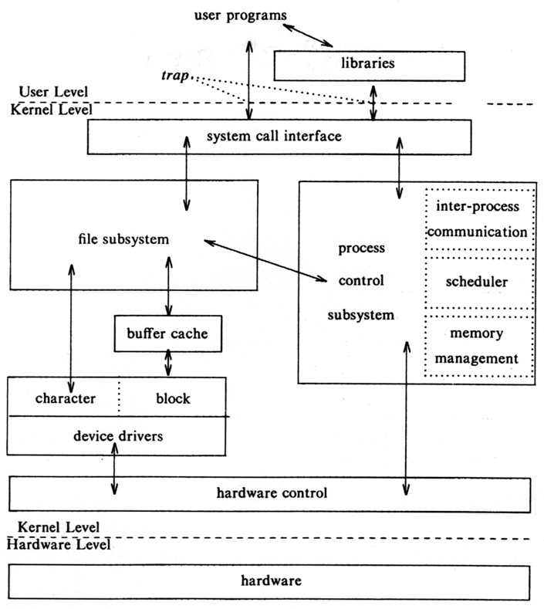
Block Diagram of System Kernel

Slide 4
Unix File Systems
Design Aspects
Types of Files
Hierarchical Organization of Files
Structure of File System
Internal Representation of Files
Related System Calls
Programming

Slide 5
What is a File in Unix?
A file is a container of text, images, code etc.
Everything is represented as a file in Unix.
Along with data and programs, the directories and I/O devices are also considered as special kind of files.

Slide 6
Types of Files
Regular Files
Contain only data. E.g. text file, program file etc.
Directory Files
Act as container and contain regular files and sub directory files entry with their corresponding inodes.
Device Files
These files represent all peripheral devices such as terminals, printers, CD-ROMS, modems, disks etc

Slide 7
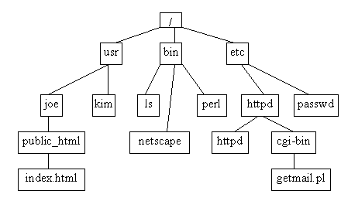
Hierarchical Organization of Files
Unix file system is organized in a tree like fashion
With root node as a root directory “/”
Every non-leaf node – Directory
Every leaf node - Regular or directory or device files

Slide 8
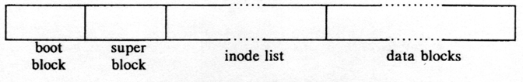
File System Structure
Unix divided physical disks into logical disks called partitions.
Each partition is a standalone file system.
a boot block is located in the first few sectors of a file system. The boot block contains the initial bootstrap program used to load the operating system.
a super block describes the state of the file system: the total size of the partition, the block size, pointers to a list of free blocks, the inode number of the root directory, a list of free inodes in the file system etc.
a linear array of inodes (short for “index nodes”). There is a one to one mapping of files to inodes and vice versa.
data blocks contain the actual contents of the file.

Slide 9
Inode
contains the information necessary for a process to access a file
It exits in a static form on disk and the kernel reads them into an in-core inode

Slide 10
Disk Inode
Disk inode consists of :
File owner identifier
Individual owner
Group owner
Set of users – access rights
Super user – access rights to all files
file type (regular, directory or device file)
file access permissions (R, W & E)
file access times (the time - file was last modified, last accessed, when the Inode was last modified)
table of contents for the disk address of data in a file
file size

Slide 11
Sample disk inode
owner mjb
group os
type regular file
perms rwxr-xr-x
accessed Oct 23 1984 1:45 P.M
modified Oct 22 1984 10:30 A.M
inode Oct 23 1984 1:30 P.M
size 6030 bytes
Disk addresses

Slide 12
In-core copy of Inode
in-core copy of the inode contains
status of the in-core inode
Inode is locked
Process is waiting for the inode to become unlocked
In-core representation of the inode differs from the disk copy as a result of a change to the data in the inode
In-core representation of the inode differs from the disk copy as a result of a change to the file data
File is a mount point
logical device number of file system
inode number (stored as a linear array on disk)
pointers to other in-core inodes
reference count (no. of instances of the file are active)

Slide 13
File System – Data Structure
Kernel contains three Data Structure
User file descriptor table
Kernel allocates this table for each running process
When a file is opened/created with in a process, its entry is made in this table.
Index of user file descriptor table is return to the user program as File Descriptor of the opened/ created file.
Other file operations use this file descriptor instead the path name.
File Table
It’s a global kernel data structure which maintains the file offset.
It also maintains access rights allowed to the opening process.
Inode Table
It’s a table of pointers to the in-core inodes which contain information of each file.
Each of the above tables makes an entry for a file.

Slide 14
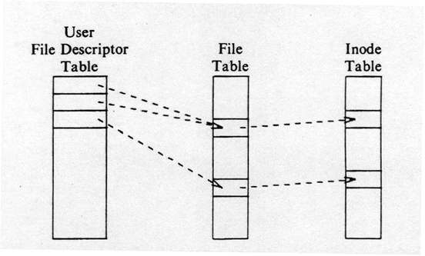
File System – Data Structure

Slide 15
File System Algorithms
Lower Level File system Algorithms
namei
alloc free ialloc ifree iget iput bmap
buffer allocation algorithms
getblk brelse bread bwrite

Slide 16
Accessing the inode : iget algorithm
Algo. iget allocates an in-core copy of an inode
Inode not found,
Allocates one from the free list and locks it
Read the disk copy of the newly accessed inode into the in-core copy
It knows the inode number and logical device – computes logical disk block that contains inode according to how many disk inodes fit into a disk block

Slide 17
Block num =
((inode number – 1) / number of inodes per block)
+ start block of inode list
Example
Block 2 is the beginning of the inode list
There are 8 inodes per block
Then inode number 8 is in disk block 2 and inode number 9 is in disk block 3
If there are 16 inodes in a disk block then inode numbers 8 & 9 are in ---disk block and inode number 17 is in --- disk block

Slide 18
Accessing the inode
Copies the contents from the disk inode to the in-core inode and returns a locked inode
The kernel manipulates the inode lock and reference count independently.
The lock is set – execution of a system call to prevent other accesses
It releases the lock at the conclusion of the system call

Slide 19
Structure of a Regular File
Table of contents in an inode
Location of a file’s data on disk
A set of disk block #
Each block on a disk is addressable by number
Not contiguous file allocation strategy
Why ?
When a file expand or contract…
Fragmentations occur

Slide 20
Sample - Fragmentation
….
File A
File B
File C
…….
40
50
60
70
….
File A
Free
File C
File B
…….
40
50
60
70
85
File B was expanded
Garbage collection – too high cost

Slide 21
Direct and indirect blocks in inode
Inode
Data Blocks
direct0
direct1
direct2
direct3
direct4
direct5
direct6
direct7
direct8
direct9
single indirect
double indirect
triple indirect

Slide 22
Suppose System V UNIX
Assume that a logical on block the file system holds 1K bytes and that a block number is addressable by a 32 bit integer, then a block can hold up to 256 block numbers
13 entries in the inode table of contents
10 direct, 1 indirect, 1 double indirect, 1 triple indirect block
Assume
a logical block = 1K bytes
a block number is addressable by a 32 bit (4 bytes) integer
a block can hold up to 256 block numbers
Byte Capacity of a File
10 direct blocks with 1K bytes each= 10K bytes
1 indirect block with 256 direct blocks= 1K*256= 256K bytes
1 double indirect block with 256 indirect blocks=256K*256= 64M bytes
1 triple indirect block with 256 double indirect blocks=64M*256=16G bytes

Slide 23
Processes
access data in a file by byte offset
view a file as a stream of bytes
The kernel
accesses the inode
converts the logical file block into the appropriate disk block
Algorithm bmap is used to map File byte offset to physical disk block

Slide 24
Block Layout of a Sample File and its Inode
4096
228
45423
0
0
11111
0
101
367
0
428
9156
824
1 disk block = 1024 bytes
byte offset 9000, byte offset 350,000
808th
367
816th
0
331
75
3333
3333
331
9156
24

Slide 25
Directories
A directory is a file
It gives hierarchical structure to the file system
Play an important role in conversion of a file name to an inode number
Its data is a sequence of entries
Contents of each entries
an inode number and the name of a file
Path name is a null terminated character string divided into components by slash (“/”)
Each component must be the name of a directory and last may not be
UNIX System V
Maximum of component name : 14 characters
Inode number entry : 2 bytes
Size of a directory entry : 16 bytes

Slide 26
Fig Directory layout for /etc
Byte Offset in Directory | Inode Number (2 bytes) | File Name
0 16 32 48 64 80 96 112 128 144 160 176 192 208 224 240 256 | 83 2 1798 1276 85 1268 1799 88 2114 1717 1851 92 84 1432 0 95 188 | .. init fsck clri motd mount mknod passwd umount checklist fsdblb config getty crash mkfs inittab

Slide 27
Questions

